Slide 1
The Speed of Diversity: Exploring Complex Interconnect Topologies for the Global Metal Layer
Oleg Petelin and Vaughn Betz
FPL 2016

Slide 2
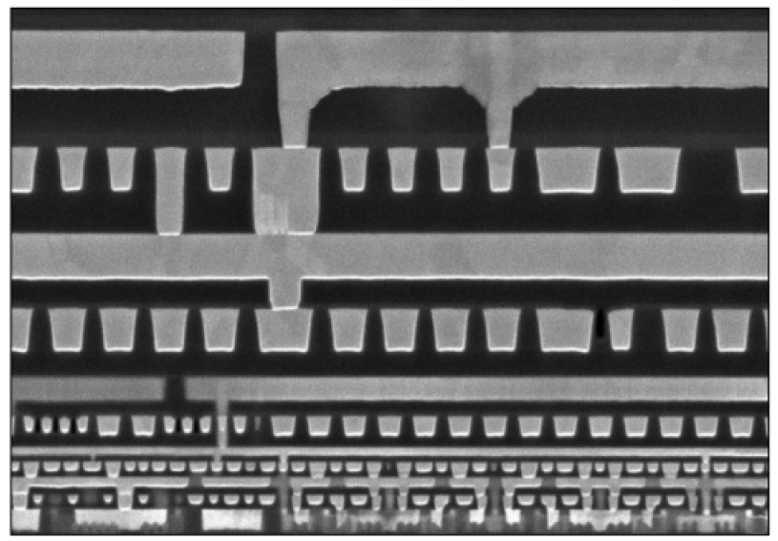
Motivation – The Metal Stack
Introduction
Poor wire RC scaling → more complex metal stack
Lower layers:
Many wires, high RC delay
Upper layers:
Few wires, low RC delay
Connecting to upper layers:
Deep via stack
Intel 14nm Metal Stack

Slide 3
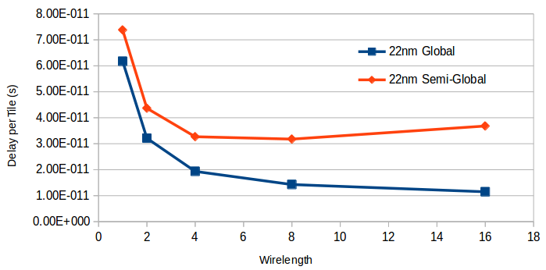
Motivation – The Metal Stack
Introduction
22nm, ITRS 2011 Interconnect Report
Metal Layer | Pitch | RC Speedup
Intermediate | 48 nm | 1x
Semi-Global | 96 nm | 7x
Global | 192 nm | 50x
80
70
60
50
Per-tile Delay (ps)
40
30
20
10
0
Global metal layer: small gain for short wires
But essential for useful longer wires

Slide 4
Contributions
Introduction
FPGA routing architecture to exploit metal stack
Scarce but faster global wires
Plentiful but resistive semi-global wires
Simultaneously explore:
Segment lengths
Layer used for each wire type
Switch patterns and interconnect hierarchies
Requires CAD Enhancements
New VPR switch block language → arbitrary switch patterns
VPR router enhancements → optimize for arbitrary interconnect

Slide 5
CAD Enhancements

Slide 6
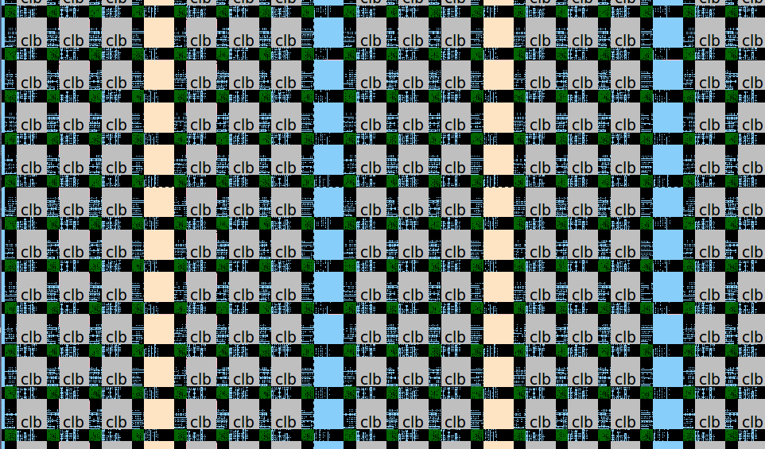
Enhanced Switch Block Descriptions
CAD Enhancements
Want to turn this…
… into this
Multi-Gigabyte Routing Resource Graph
Architecture Description File:
<switchblock>
…
…
Concise, human-readable, general
description format
…
…
</switchblock>

Slide 7
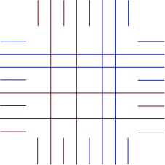
Enhanced Switch Block Descriptions
CAD Enhancements
Current – limited flexibility:
Specify which tracks connect
Regardless of wire type and whether wire end or midpoint
VPR 7.0 patterns hard-coded:
Switch pattern in one keyword, e.g. Wilton, Universal, …
New – more flexible & general
Distinguishes between wire types and wire endpoints/midpoints
Uses mathematical permutation functions (not keywords) to implement connections
0
1
3
2
L3
1
0
1
1
1
L2
0
0
0
0
1
2
3
Left → Top
L2 midpoints→ L3 endpoints
Permutation = t
Right → Bottom
L3 mid/endpoints → all endpoints
Permutation = W-t
Left → Right
L2 endpoints → L2 endpoints
Permutation = t+1

Slide 8
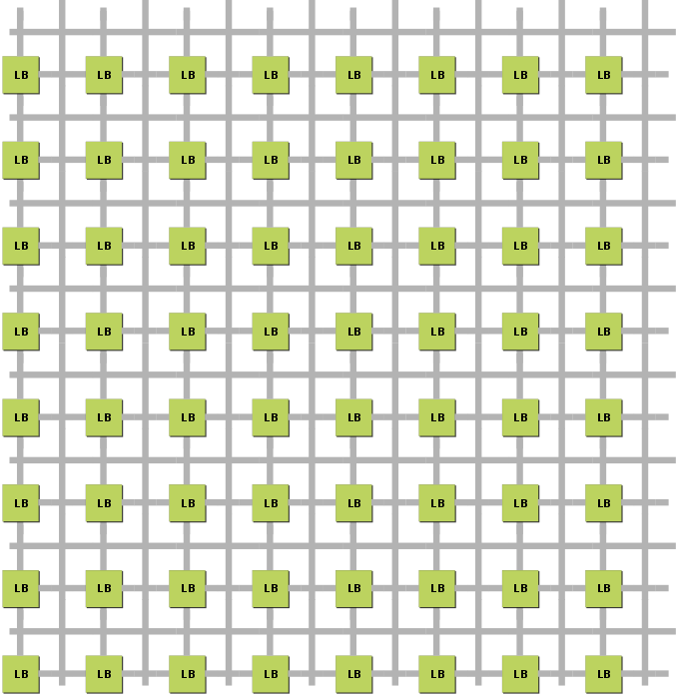
Enhanced Router Lookahead
CAD Enhancements
How to route a connection?
BFS → Simple, impractically slow
Fast routers use a lookahead to estimate remaining cost from intermediate routing points
Good lookahead → fast, directed routing

Slide 9
Enhanced Router Lookahead
CAD Enhancements
How to estimate remaining cost?
VPR 7.0: assume the same wire type can be used to finish the route in an optimal number of segments
→ Efficient, limiting
Independence: makes absolutely no assumptions about the FPGA architecture to build large lookup tables of routing costs
→ Very general, very memory-hungry
(multiple GBs for 200 x 200 FPGA)
Proposed: perform BFS sample routings to build lookup tables of routing costs for each relative coordinate offset
Exploit symmetries that exist in island-style FPGAs
→ Fast, memory efficient, handles complex interconnect
(10s of MBs for 200 x 200 FPGA)
Lookup[wire type A][x-chan][1][3] = 0.6ns
Lookup[wire type B][y-chan][5][5] = 1.3ns
From wire type
From channel
|Δx|
|Δy|
Notes:
- Add slide 6

Slide 10
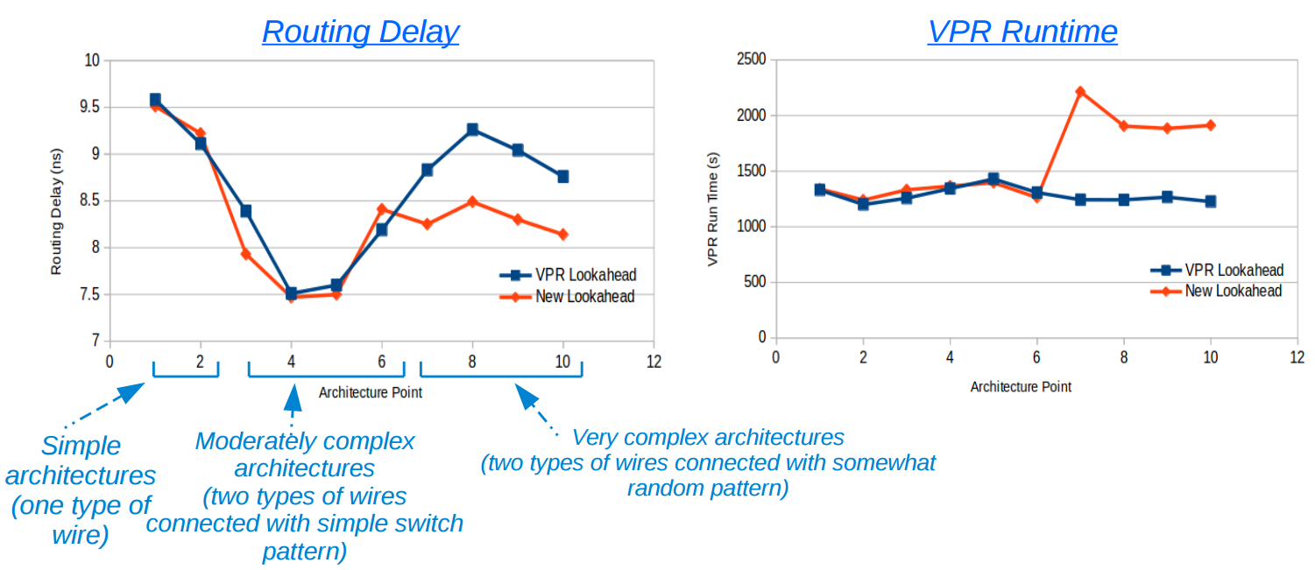
Enhanced Router Lookahead
CAD Enhancements

Slide 11
Complex Interconnect Exploration

Slide 12
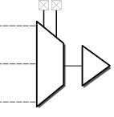
Exploration Methodology
Complex Interconnect
22nm architectures generated with COFFE
85% semi-global layer wires
15% global-layer wires
Deep via stack layout difficulties → Global wires have connections every 4 tiles
Unidirectional Switches
semi-global
L=4
global
L=8

Slide 13
Exploration Methodology
Complex Interconnect
9 Largest VTR Benchmarks:
Architecture:
Parameter | Primary Arch | Arch for Verification
Logic Block | Ten 6-LUTs | Eight 4-LUTs
Logic Block Crossbars | Input | None
Block RAM | 32K | 18K
DSP | 36x36 | 36x36
Channel Width | 300 | 200
Connection Block Flex | 0.1 | 0.2
Semi-Global Wirelength | 4 | 2
Global Wirelength | 4, 8, 16 | 4, 8, 16
Interconnect Hierarchy | Discussed Later | Discussed Later
Benchmark | #6-LUTs
mcml | 99,700
LU32PEEng | 75,530
bgm | 30,089
stereovision2 | 29,849
LU8PEEng | 21,954
stereovision0 | 11,462
stereovision1 | 10,366
blob_merge | 6,016
mkDelayWorker32B | 5,580

Slide 14
Complex Topologies Explored
Complex Interconnect
Topology name represents connectivity of wires on global metal layer
CB: Connection Block
SB: Switch Block
85%, L4
85%, L4
85%, L4
15%, global
15%, global
15%, global
(1) On-CB, Off-CB
(2) On-CB, Off-SB
(3) On-CB, Off-CB/SB
55%, L4
75%, L4
30%, L4*
10%, L4*
15%, global
15%, global
(4) On-SB, Off-SB
(5) On-CB/SB, Off-CB/SB

Slide 15
Routing Example – “On-CB, Off-CB”
85%, L4
15%, global

Slide 16
Routing Example – “On-SB, Off-SB”
55%, L4
30%, L4*
15%, global

Slide 17
VPR 7.0 Default
Complex Interconnect
85%, L4
15%, global
Connects to wire segment start points without distinguishing between wire types
Connects tracks using Wilton permutation function, with unidirectional legalization
Only semi-global layer wires
Notes:
Add no global wire point.

Slide 18
(1) On-CB, Off-CB
Complex Interconnect
85%, L4
15%, global
Regular and fast wires form distinct routing networks
Used in previous published studies
Worse delay than VPR default (Wilton over all wires)
Deep via stack restrictions → global wires too hard to use

Slide 19
(2) On-CB, Off-SB
Complex Interconnect
85%, L4
15%, global
On-CB → every output pin is guaranteed a connection to fast routing
Off-SB → increased routing flexibility compensates for decreased flexibility from deep via stacks
Routing delay improved by 5-11%

Slide 20
(3) On-CB, Off-CB/SB
Complex Interconnect
85%, L4
15%, global
Global wires driving switch blocks AND connection blocks adds a small amount of extra routing flexibility
More switches, but not much gain

Slide 21
(4) On-SB, Off-SB
Complex Interconnect
85%, L4
15%, global
Connect to global-layer wires exclusively through regular routing wires
Improves the delay of long wire segments
Driving long global wires from regular routing adds much-needed flexibility
Long global-layer wire delay improved by 14%
14%
delay
red.

Slide 22
(5) On-CB/SB, Off-CB/SB
Complex Interconnect
85%, L4
15%, global
Little improvement over previous topologies for all global wire segments lengths
Connection blocks add little routing flexibility to fast wiring given deep via stack restrictions

Slide 23
Verifying Results with Different Logic Block Architecture
Complex Interconnect
4-LUT logic block without input/output crossbars
Trends similar to 6-LUT arch
But lack of internal crossbars makes switch block connections between semi-global and global wires more important
13%
delay
red.

Slide 24
Complex Interconnect Summary
Complex Interconnect
Short Global Layer Wires (L=4):
Drive from connection block → immediate access to fast routing
Drive regular (semi-global) wires → routing flexibility compensates for deep via stacks
Long Global Layer Wires (L=16):
Drive from regular (semi-global) wires →compensate for few start points of long unidirectional wires
Drive regular (semi-global) wires
Shorter global-layer wires (L = 4) perform surprisingly well
Shorter wires have better routing flexibility → more signals can use fast routing
Good “routing hierarchies” reduce delay by 5-14% vs. VPR default switch and 13% - 15% vs. disjoint global / semi-global networks
semi-global
global
semi-global
global

Slide 25
Summary of Contributions
Conclusions
General but concise switch block description in VPR
And automatic creation of matching routing resource graph
General but computationally efficient router lookahead
~10% faster circuits with complex switch patterns
Exploration of interconnect hierarchies to take advantage of routing on the global metal layer
Good interconnect hierarchy 5-14% faster than VPR’s best prior switch pattern

Slide 26
Future Work
Conclusions
Deep via stack layout difficulty → restricted global-layer wire connections to one in four tiles
Repeat explorations when global-layer via connections are allowed every 2, 8, etc. tiles
Considered one global-layer wire type (length) at a time
Mixes of wire lengths on the global layer may yield further gains
Many new switch fabrics now possible
Different patterns, unbalanced multiplexer size/flexibility, …

Slide 27
Thank You! Oleg Petelin opetelin@eecg.toronto.edu Vaughn Betz vaughn@eecg.toronto.edu

Slide 28
Appendix A
Complex interconnect topology per-tile areas
6-LUT logic block

