Slide 1
Configurable and Scalable Belief Propagation Accelerator for Computer Vision
Jungwook Choi and Rob A. Rutenbar

Slide 2
Belief Propagation FPGA for Computer Vision
Variety of pixel-labeling apps in CV are mapped to probabilistic graphical model, effectively solved by BP
FPGA acceleration ➔ Better {Performance/Watt} + Reconfigurability
Stereo Matching
Image denoising
Object segmentation

Slide 3
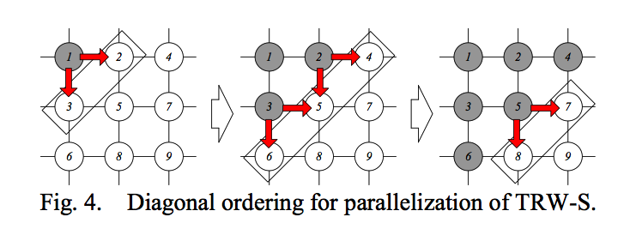
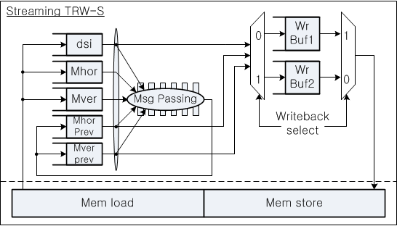
Before: Point-Accelerators for BP [FPL 2012, FPGA 2013]
Very fast stereo matching, but not configurable to other BP problems
Pipelined, but not scalable/parallel (only one PE consumes entire mem BW)
Pipelined Message Passing Arch
Video Stereo Matching Benchmark

Slide 4
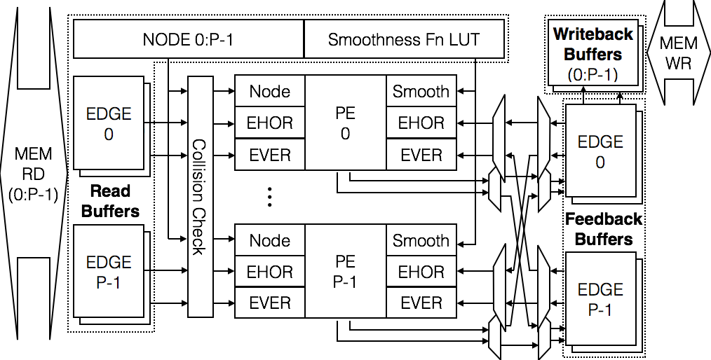
New: Scalable/Configurable BP Architecture
Not just a pipeline any longer: really parallel…
Efficient new memory
subsystem overlaps
BW and computation,
checks for data conflicts
P Parallel
processor elements
(pixel streams)
Novel, Configurable
Factor-Evaluation
unit removes the
O(|Labels|²) complexity

Slide 5
Fast Configurable Message Passing: Jump Flooding
Problem: BP message computation quadratic in L=|Labels|
Solution: Jump Flooding* BP msg approx = L log(L)
Analogy: Like “FFT”, smart order for label arith & comparisons
Cost fn for inrerence
Jump Flooding
Message Passing Unit
*[Rong, Tan, ACM Symp Int 3D, 2006]

Slide 6
Results: Positive Scalability
2, 4 PEs running (limited by Xilinx V5 size); sims 1-16 PEs
  Parameterized by “Bandwidth needed to feed P processors”
  If we can feed the architecture – promising scalability
Execution Time vs (Mem BW for P processors)
P=2
P=4
Normalized Mem BW to Feed P Proc (mem blocksize B=4 fixed)

Slide 7
Results: Configurable BP Architecture
12-40X faster than software (PE = 4); no loss of result quality
First “custom HW” to ever run >1 {Middlebury,OpenGM} benchmarks
Comparison of Execution Time (in sec) for
{Middlebury[1], OpenGM[2]} Benchmarks
Inference Results for {Middlebury,OpenGM}
Speed comparable to “point-accelerator”
[1] R. Szeliski, R. Zabih, D. Scharstein, O. Veksler, V. Kolmogorov, A. Agarwala, M. Tappen, and C. Rother, “A comparative study of energy minimization methods for Markov random fields with smoothness-based priors,” IEEE Trans. Pattern Anal. Mach. Intell., vol. 30, no. 6, pp. 1068– 1080, 2008.
[2] J. H. Kappes, B. Andres, F. Hamprecht, C. Schnorr, S. Nowozin, D. Batra, S. Kim, B. X. Kausler, J. Lellmann, N. Komodakis et al., “A comparative study of modern inference techniques for discrete energy minimization problems,” in CVPR. IEEE, 2013, pp. 1328–1335.

