Slide 1



Bayesian Inference implemented on FPGA with Stochastic Bitstreams for an Autonomous Robot
Jorge Lobo
jlobo@isr.uc.pt

Slide 2
Bayesian Inference implemented on FPGA with Stochastic Bitstreams for an Autonomous Robot
Introduction
The Bayesian Machine and Compilation Toolchain
Bayesian Machine Implementation with Stochastic Computing
Results for Autonomous Robot Sensorimotor System
Conclusions and Future Work

Slide 3

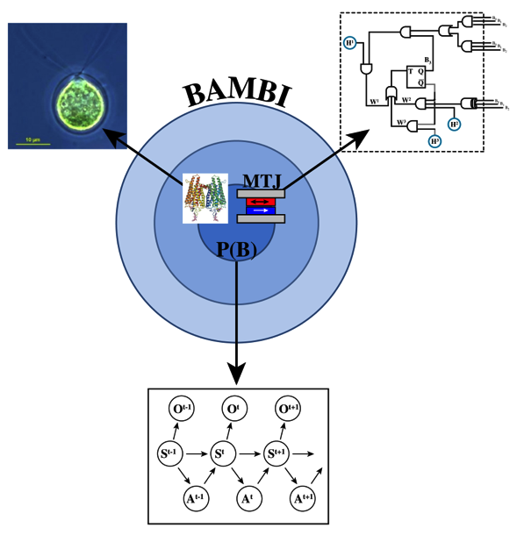
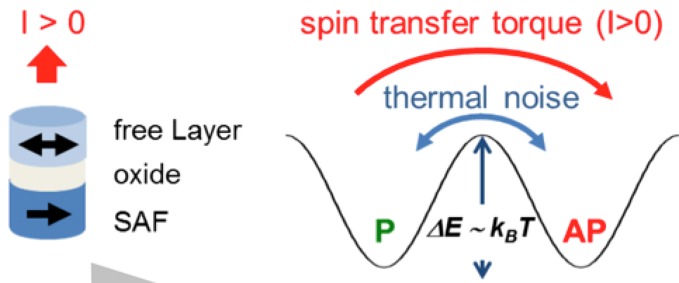
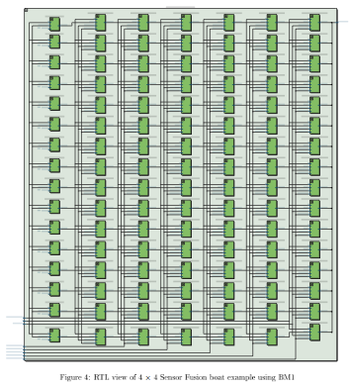
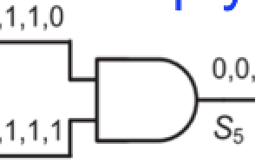
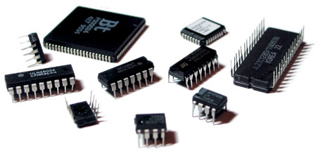
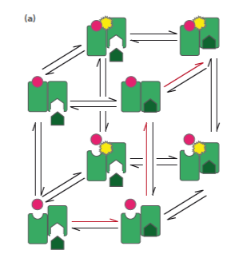
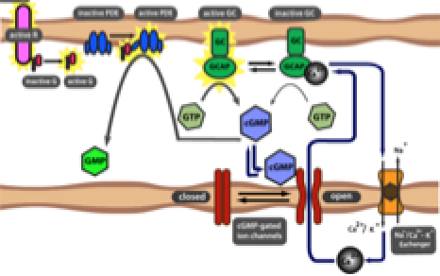
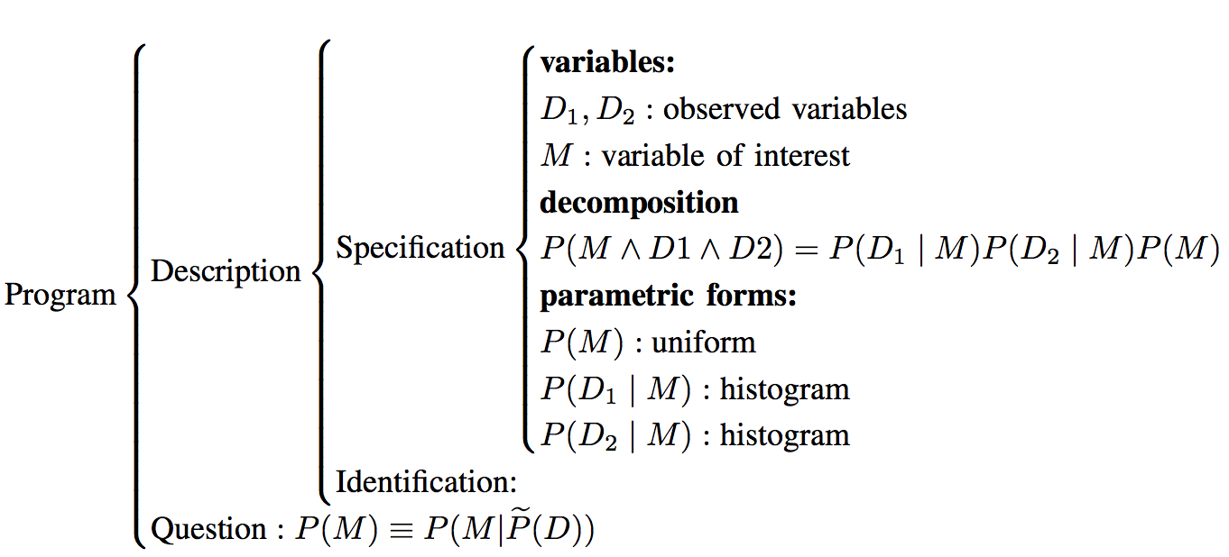
BAMBI
Bottom-up Approaches to Machines dedicated to Bayesian Inference
  Probabilistic
  inference in
  biology
  Hardware
  implementation
  theory of probabilistic
  computation

Slide 4
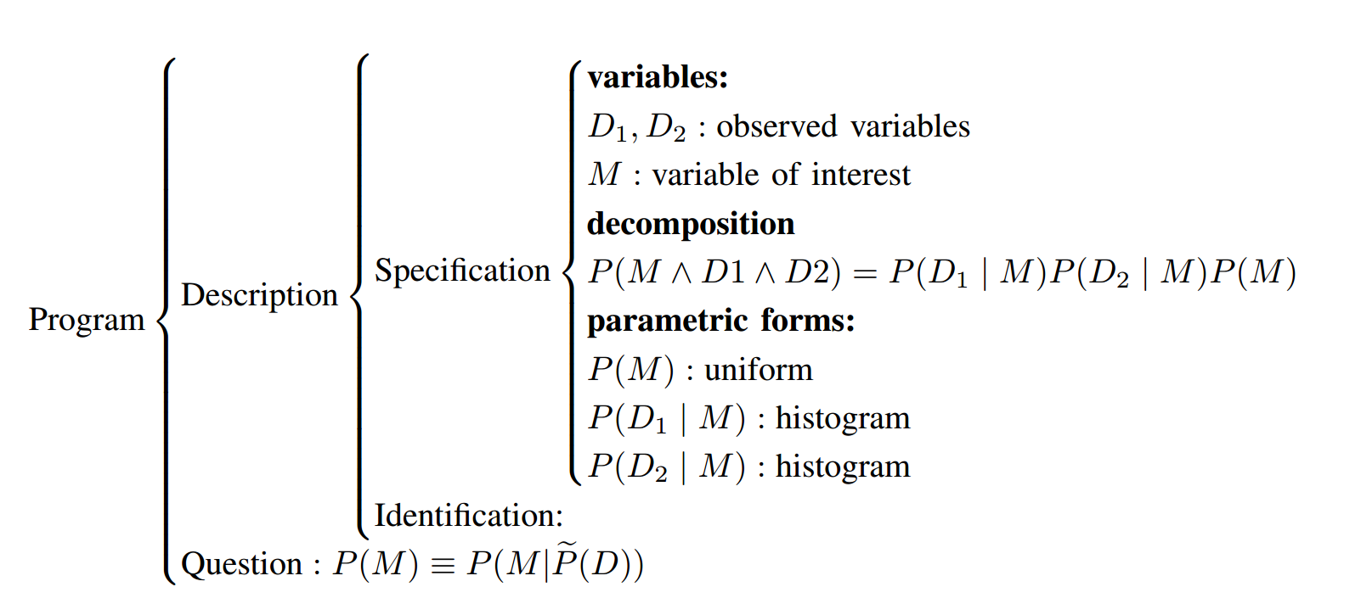
Bayesian Programming

Slide 5
The Bayesian Machine Compilation Toolchain
a

Slide 6
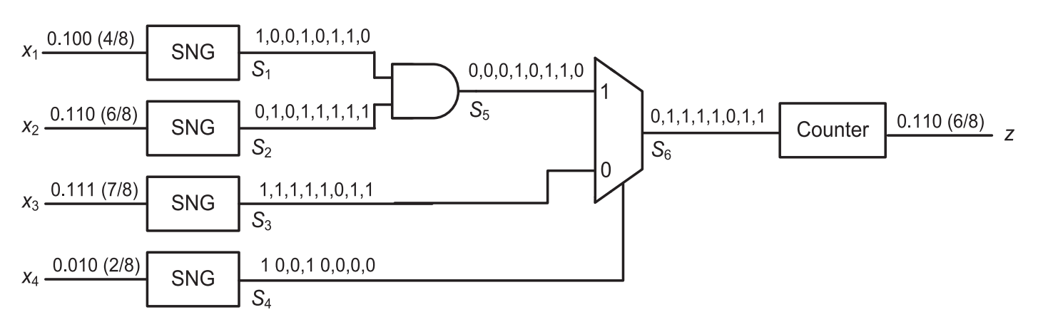
Revisiting Stochastic Computing…
Simple logic gates perform multiplication and sums

Slide 7
RTL view of full system

Slide 8
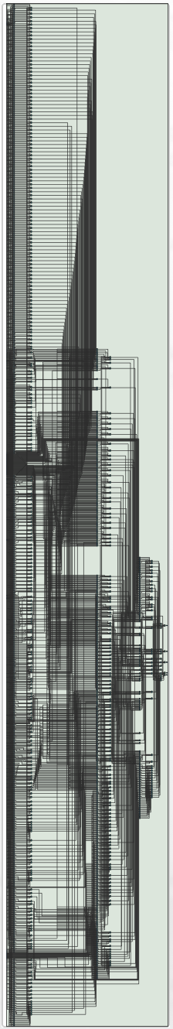

BM for robot steering

Slide 9
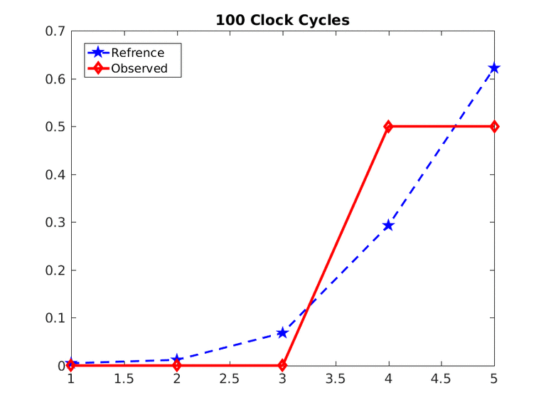
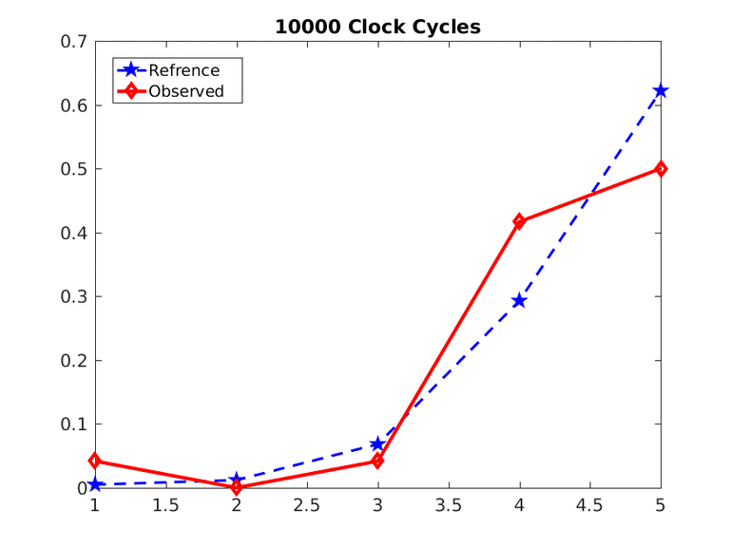
Results
Output distribution (robot steering)

Slide 10
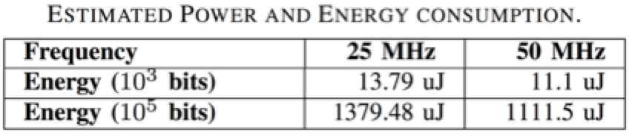
Results
Accuracy
Resources
  Most LEs used up by RNGs and not the BM
Energy

Slide 11
Conclusions and future work
Energy used in computation same order of magnitude as laptop using floating point
Good when the robot onboard computing power is very limited, and problems with big cardinality need to be tackled.
A shorter bitstream length has less accuracy, but gets a usable result with less energy.
If direct stochastic bitstreams can be used by both sensors and actuators, this approach does have a significant edge, since the conversion circuits dominate resource usage.

Slide 12
Bayesian Inference implemented on FPGA with Stochastic Bitstreams for an Autonomous Robot
Jorge Lobo
jlobo@isr.uc.pt

Slide 13
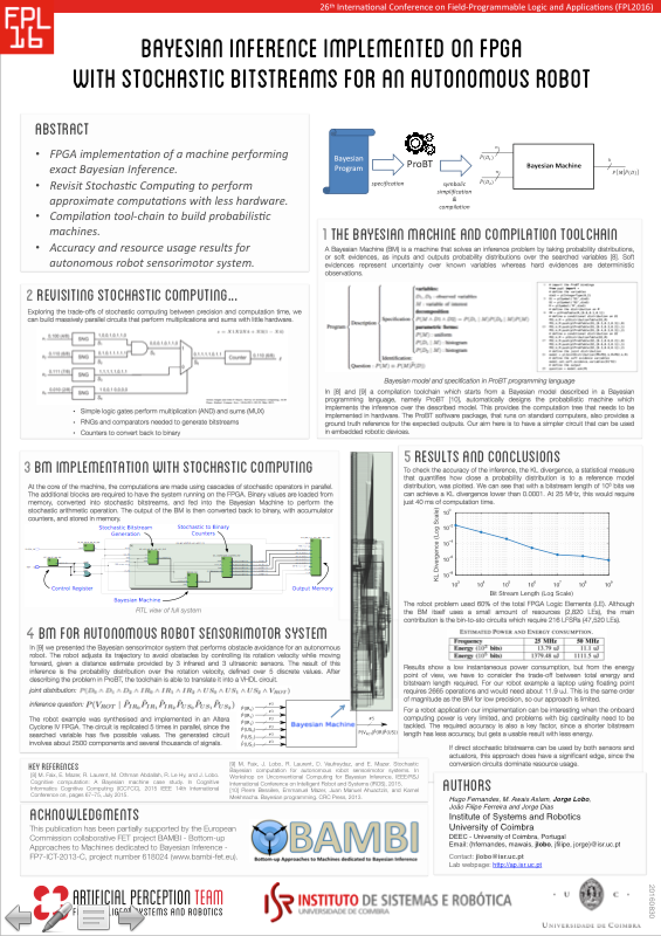
Bayesian Inference implemented on FPGA with Stochastic Bitstreams for an Autonomous Robot
Jorge Lobo
jlobo@isr.uc.pt

Slide 15
Results
KLD /bitstream length

Slide 16
Results
KLD /energy

