Slide 1
Improved Resource Sharing for FPGA DSP Blocks
Bajaj Ronak
School of Computer Science and Engineering, Nanyang Technological University, Singapore.
Suhaib A Fahmy
School of Engineering, University of Warwick, UK.
1st Sep, 2016.

Slide 2
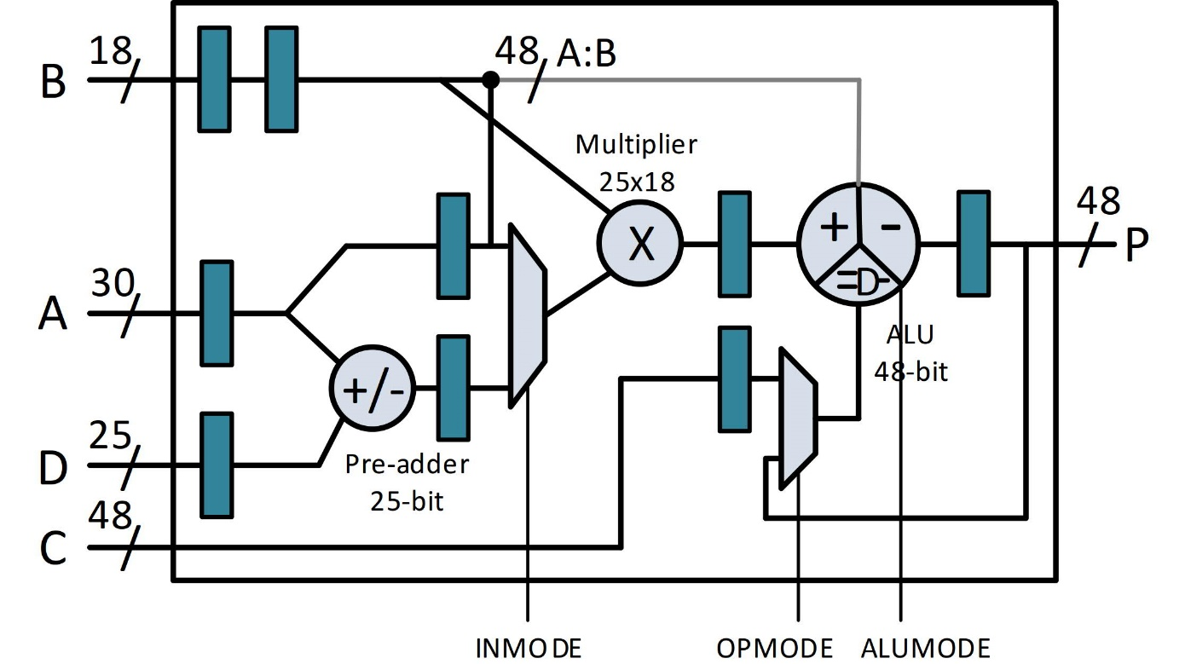
Xilinx DSP48E1 Primitive
Three sub-blocks:
Pre-adder
Multiply
ALU
Up to four pipeline stages
Supports dynamic programmability
Functionality can be changed per clock cycle
17-bit configuration input

Slide 3
Xilinx DSP48E1 Primitive
iDEA Soft Processor
Exploit dynamic programmability to build a small, fast (400MHZ+ soft processor)
[FPT2012, TRETS 2014]
FPGA Overlays
Exploit dynamic programmability in flexible processing elements
Makes fast, area-efficient overlays
[FCCM2015, HEART 2015, DATE 2016, FCCM 2016]

Slide 4
Resource sharing
Hard blocks like DSP48E1 are typically a constrained resource, and resource sharing should be applied where possible
Traditional resource sharing:
Operations scheduled in non-overlapping time schedules mapped to a set of hardware blocks
Input and output muxes controlled through a state machine
Major disadvantages:
Increased schedule length
High initiation interval (II) due to multi-cycle DSP blocks
Structure of DFG of design limits the best achievable II, thus throughput

Slide 5
Improved Resource sharing
Proposed scheduling and implementation technique for II driven resource sharing
Splits operations across multiple banks of DSP blocks, such that each bank meets targeted II
Opens up space between fully unconstrained implementation and traditional resource sharing
Results in significant resource savings compared to resource unconstrained implementations
Dynamic programmability of DSP block is exploited to map different sets of operations onto the same DSP block primitive

Slide 6
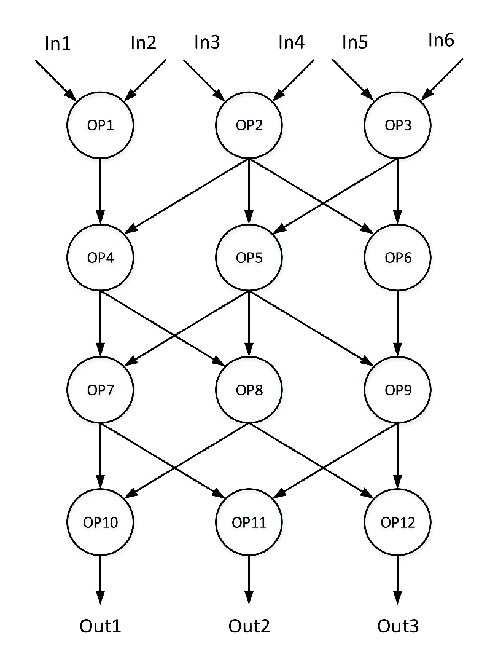
Illustrative Example
Maximum number of DSP blocks in a schedule time = 3 (due to data dependencies)
Best II achievable = 16
 | #DSP=1 | #DSP=2 | #DSP=3
Sch Length | 62 | 32 | 22
II | 56 | 26 | 16

Slide 7
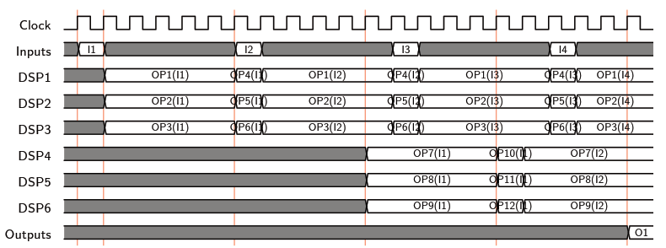
Illustrative Example
Proposed approach uses more DSP blocks for better II
 | II=16 | II=11 | II=6 | II=1
Sch Length | 22 | 32 | 22 | 22
DSP Blks | 3 | 4 | 6 | 12
II = 6

Slide 8
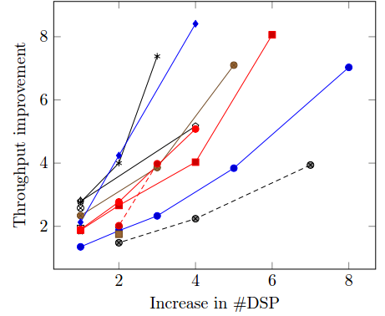
Results
Throughput gain with increase in DSP block usage
Increase in DSP is from best throughput achievable using TRS1.8× throughput improvement with 1.4× increase in DSP for II of 11
For II of 6, throughput improvements up to 8× at a cost of 3× increase in DSP blocks
All these design points are inaccessible using traditional approach

Slide 9
Thank You

