Slide 1
Hardware-Software Codesign of RSA for Optimal Performance vs. Flexibility Trade-off
Malik Umar Sharif, Rabia Shahid, Marcin Rogawski, and Kris Gaj George Mason University USA
Supported in part by NIST/U.S. Department of Commerce
under Grant No. 60NANB15D058

Slide 2
Primary Designers & Co-Authors
Malik Umar Sharif
Rabia Shahid
Marcin Rogawski
PhD Students
in the Cryptographic Engineering
Research Group (CERG) at GMU
Former PhD Student
Cadence Design Systems
San Jose, CA

Slide 3
Cryptography at Crossroads
Traditional
Cryptography
Post-Quantum
Cryptography
Transition
Period
Hash-based
Code-based
Lattice-based
Multivariate
(emerging standards)
RSA
Elliptic Curve Cryptosystems
(existing standards)
Attacks using
quantum computers
classical computers
Complete collapse
Trusted resistance
Trusted resistance
Limited trust

Slide 4
Solutions for the Transition Period
Traditional Scheme
(e.g., RSA)
Post-Quantum Scheme
(e.g., NTRU)
Maximum flexibility with the choice of parameters and key sizes
Hardware acceleration crucial because of high-computational complexity

Slide 5
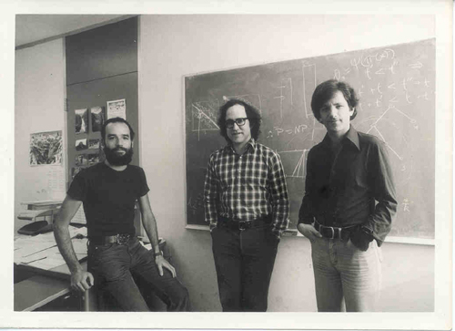
Why RSA?
The oldest and most trusted
public key scheme
Baseline for evaluation of
post-quantum cryptosystems
Simple description:
Encryption and decryption
equivalent to modular
exponentiation, Y=XE mod N
Rivest
Shamir
Adleman
MIT, 1977

Slide 6
Basic Operations of RSA
Modular Exponentiation: Y = XE mod N
Mod Exp
Mod Mul
Modular Multiplication: C = A∙B mod N
Typical operand sizes: 512-2048 bits

Slide 7
Our Platform – Zynq-7000 & ZedBoard
Processing System (PS) – ARM based Microprocessor System
Software in C based on RELIC (Efficient LIbrary for Cryptography)
Free
Optimized for embedded systems
Programmable Logic (PL) – a 28nm Artix-7-based reconfigurable logic
Hardware in VHDL based on architecture by Orup-Suzuki
DSP-unit based
Optimized for maximum clock frequency

Slide 8
Design Options
Software in C
Hardware in VHDL
Mod Exp
Mod Exp
Mod Exp
Mod Mul
Mod Mul
Mod Mul
Most Flexible
Least Efficient
Most Efficient
Least Flexible
Best Balanced

Slide 9
Features of our Solution
Three modular exponentiation schemes:
Left-to-Right (L2R),
Right-to-Left (R2L)
Sliding Window (SLID)
selected at run time
Four operand sizes:
512, 1024, 1536, 2048 bits
selected at run time
Mod Exp
Mod Mul
Maximum flexibility
and scalability

Slide 10
Speed-up vs. Software Based on RELIC

Slide 11
Future Work
Implementation of selected post-quantum cryptographic algorithms on Zynq using the similar software/hardware co-design approach
Implementation of the hardware portions using High-Level Synthesis
Poster: 3:30-4:15pm
http://cryptography.gmu.edu

